Slide 1
Software Delivery for SCCM
OVER 4 MILLION
END POINTS DEPLOYED ACROSS
GLOBAL 2000 ENTERPRISES
Notes:
Kollective is the leading provider of comprehensive video solutions for the enterprise with over 15 years of experience providing solutions for some of the world’s largest and most dynamic organizations. Key Quick Facts:
Mature, Patented Technology for Solving the Enterprise Delivery Problem
Market Firsts: Software-Defined Enterprise Content Delivery Network (SD ECDN), Network Readiness Test, Self-Service Webcasting, “YouTube for the Enterprise” and Peer-Assisted ECDN
Over 4 million end points deployed across Global 2000 enterprises
Support hundreds of live webcast events monthly for our enterprise customers including those attended by tens of thousands of viewers
Incredibly Close Customer Community for exchange of Best Practices and Process-Oriented information critical to a successful video strategy – 97% renewal rate

Slide 2
AGENDA
Software Distribution – The transition to continuous deployments
Windows 10 – Migration to Windows as a Service
SCCM – The evolution of Distribution Point based infrastructure
Kollective – The market leader in peer-assisted distribution

Slide 3
4 GB twice a year
1GB every month
File size and frequency of WaaS feature releases and patch updates going forward…forever

Slide 4
WINDOWS 10 AS A SERVICE
Are you ready for semiannual OS migrations?
Feature Updates
Quality Updates
Repeat Perpetually
Twice per year 4GB OS migrations
In-place upgrades
Monthly cumulative 1GB updates
Security, reliability, bug fixes, etc.
Supersedes previous month
Windows 10 is the last version
Ongoing continuous development
Notes:
These changes are being implemented for older versions of Windows as well.

Slide 5
1 Billion
PCs still on Windows 7

Slide 6
845 days
Days you have to migrate to Windows 10

Slide 7
1.2 million
PCs need to be upgraded daily to meet the 2020 deadline

Slide 8
2020 DEADLINE FOR MIGRATION TO WINDOWS 10
Desktop Operating Systems by Market Share
Over 1 Billion PCs need to migrate to Windows 10
Windows 7 Extended Support ends January 14, 2020
NetMarketShare.com Dec 2016
Notes:
There are miles to go, before Windows 10 displaces Windows 7 in market share.
Estimates place devices running Microsoft operating systems around 2 billion end points.
Current number of Windows 10 end points is around 500 million mark.
So, nearly 1.5 billion devices will need migration prior to January 2020 the end of Windows 7 extended support.
Microsoft SCCM 1703 telemetry reports –
38,000 customers reporting with 83 Million endpoints between them, only 15 Million currently on Windows 10.

Slide 9
ENTEPRISE END POINT SECURITY
Risks and costs of malware downtime and data breaches skyrocketing
Over 10,000 organizations affected by WannaCry
98% of PCs infected were Windows 7
$22k a minute in lost productivity by auto manufacturers
$500 Billion global ransomware costs in 2017 (15x two year increase)
$2.1 trillion projected global data breach costs by 2020
- NY Times Sep 7, 2017
- Bloomberg Sep 19, 2017
- Forbes Sep 20, 2017
- Reuters Sep 20, 2017
Notes:
K There are miles to go, before Windows 10 displaces Windows 7 in market share.
Estimates place devices running Microsoft operating systems around 2 billion end points.
Current number of Windows 10 end points is around 500 million mark.
So, nearly 1.5 billion devices will need migration prior to January 2020 the end of Windows 7 extended support.
Microsoft SCCM 1703 telemetry reports –
38,000 customers reporting with 83 Million endpoints between them, only 15 Million currently on Windows 10.

Slide 10
TRUER WORDS WERE NEVER SPOKEN
“Windows migration is a significant change process for most firms. The migration process from one version of Windows to the next is a significant investment of time and resources — especially those with large application estates.”
David K Johnson – Forrester Research
Notes:
Windows migrations are one of the least favorite projects for IT, they usually cause significant disruption to a business in terms of cost, time and user experience.

Slide 11
MANAGING THE SYSTEMS MANAGEMENT INFRASTRUCTURE
“Configuration Manager is server-heavy in highly distributed environments, which adds cost and complexity for organizations with a large number of small sites.”
Magic Quadrant for Client Management Tools 2014
Gartner
“Highly distributed organizations with a large number of branch offices may still require servers in each location. Therefore, organizations with a large number of branch offices may require a large number of servers.”
Complementary Solutions for
Microsoft System Center 2012 Configuration Manager
Gartner

Slide 12
SCCM - HISTORICALLY SERVER HEAVY
Hardware based infrastructure requires significant overhead
Distribution Points are a single point of failure
Up to 20% of DPs experience issues at any given time
Significant time and cost to build DP infrastructure
Upgrade of infrastructure alone can take months
Software distribution to DP’s alone can take weeks
Notes:
Depending on a different factors (size of the environment, system locations, etc., etc.)….
The time spent managing the various bits of SCCM infrastructure, may take more time the actual tasks of managing desktops, laptops and devices.

Slide 13
“We don’t necessarily care which peer to peer mechanism you put in place.
We just recommend that you have one, in order to enable efficient distribution of these large packages that would be pushed around your network.
With these in place, 90% of the traffic can be shifted away from that core distribution point and out to the edges of the network.”
Michael Niehaus, Director, Windows Commercial
Implement Windows as a Service: understanding how to do it
Microsoft Tech Summit Jan 24, 2017
Notes:
His very next sentence mentions, distribution points breathing a sigh of relief, as they no longer have to handle getting the content to all those PCs.
To me that unequivocally states DPs are a bottleneck for patching, as we also know they limit scalability during OS deployments.
WIP
Highlight gaps and pre requisites for other peer to peer solutions
Show Kollective as only solution to fully cover both today and tomorrow operating systems completely

Slide 14
KOLLECTIVE SD ECDN
An adaptive, peer-assisted delivery network supporting software distribution
A Software Defined Content Delivery Network (SD ECDN) enables the efficient transfer of data within an enterprise
Software overlay that accelerates payload delivery
Peer-assisted technology
Self-optimizing performance
Rapid deployment with little operational overhead
Near limitless scalability
Notes:
Pause on this slide while the animation starts
Self-scaling, peer-assisted delivery network supporting content delivery within SCCM,
for multiple tens of thousands of concurrent devices while eliminating 90-95% of WAN and internet gateway traffic
Fully software-defined configurability for region-to-region control over bandwidth use, peering policies, protocols, preferred bitrates, etc., etc.

Slide 15
SW DISTRIBUTION WITHOUT KOLLECTIVE
Extensive Distribution Point infrastructure
Slow deployment of installs & updates
Scheduled off-peak hour updates
Corporate Office
Sequential batch updates
MSFT SCCM
Distribution Point

Slide 16
SW DISTRIBUTION WITH KOLLECTIVE SD ECDN
Rapid distribution of installs and updates
Intelligent distribution during device inactivity
Significant reduction in distribution points
Corporate Office
Peer-Assisted Updates
Internet
MSFT
ACP
MSFT SCCM
Kollective SD ECDN
Notes:
With Kollective, we protect your network.
Whether you backhaul internet traffic through the WAN or connect directly in remote office to the Internet, we minimize the traffic across those key network links.
Within the remote office, we create a mesh or a smart grid that allows the stream to be shared from machine to machine using dynamic optimization algorithms.
The smart grid is constantly looking for the best way to optimize the movement of information across the grid.
The key – regardless how dynamic the load changes are within an office, the Kollective SD ECDN protects those WAN and internet gateway links from being inundated with traffic.
Use the builds in this slide to show how the peering works. Then the LAN Leader drops out and the new LAN Leader takes over.

Slide 17
PEER ASSISTED VS SEQUENTIAL DISTRIBUTION
Corporate Office
Corporate Office
20-40 Machines per evening per distribution point
Sequential batched updates
Thousands of machines per day
Peer-Assisted Updates
MSFT SCCM
Distribution Point
MSFT SCCM
Kollective SD ECDN
Peer-assisted distribution significantly accelerates installations and upgrades

Slide 18
REDUCE DISTRIBUTION POINT OVERHEAD
Faster software distribution with less hardware infrastructure
X
X
X
X
X
X
X
X
X
X
X
X
X
X
X
Microsoft SCCM
X
X
X
X
X
Significantly reduce the need for Distribution Point servers

Slide 19
REDUCE DISTRIBUTION POINT OVERHEAD
Faster software distribution with less hardware infrastructure
Microsoft SCCM
Repurpose Distribution Point hardware and support resources to other use cases

Slide 20
THE WORLD’S BIGGEST BRANDS TRUST KOLLECTIVE
Notes:
Logos in deck – not to be used publicly – this is for 1:1 with a prospect
Kollective has over 100 customers worldwide and we continue to add new brands to our customer list daily.
With over 30% of Kollective employees dedicated to customer support, our customers have a high degree of trust. The true measure of this trust is loyalty – 97% of our customers renew their contracts each year.

Slide 21
EXTENSIBLE PLATFORM FOR MULTIPLE USE CASES
A Single Delivery Network for Bandwidth-Intensive Applications
SCCM Systems Management
Live Webcasting and Video on Demand
Skype Meeting Broadcast & O365 Video
Kollective Enterprise Content Delivery Platform
Technology Partners
Solution Partners

Slide 22
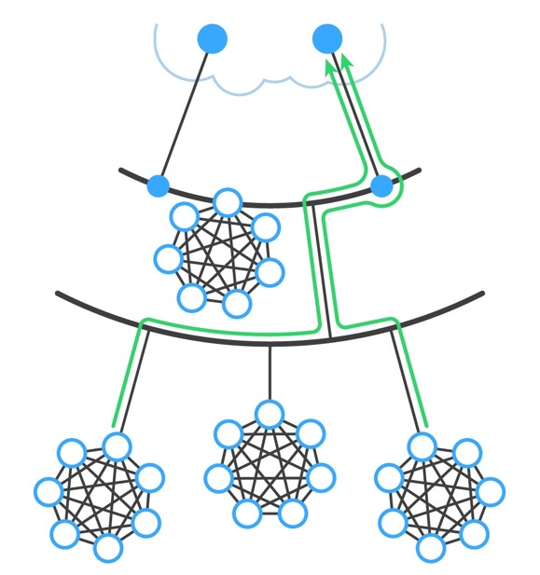
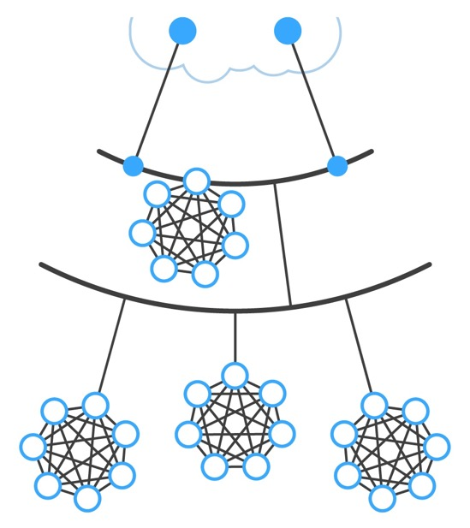
SELF-OPTIMIZATION
Broadcast subnet discovery
Periodic graph & metrics reporting to central directory
Trace, ping and bandwidth tests
3 hops
25ms RTT
15mb/s
2 hops
5ms RTT
85mb/s
Notes:
Essential to the operation of the peering grid is a knowledge of topology, round-trip times and throughput between various parts of the corporate network. The Kollective system automatically discovers and collects this information into local and global directories. These directories are then used to inform optimal mesh formation to maximize delivery throughout and minimize traffic over shared links.
This is a build slide that shows:
Example segment of a corporate network with deployed Kollective client agents.
Discovery of subnet peers by broadcast or multicast.
Discovery of network topology via trace routing to central servers and between nodes, then running instantaneous throughput tests to measure latency and available bandwidth.
Periodically reporting routes and metrics to a central directory service to provide both a soft, global view and an accurate local view of the network.

Slide 23
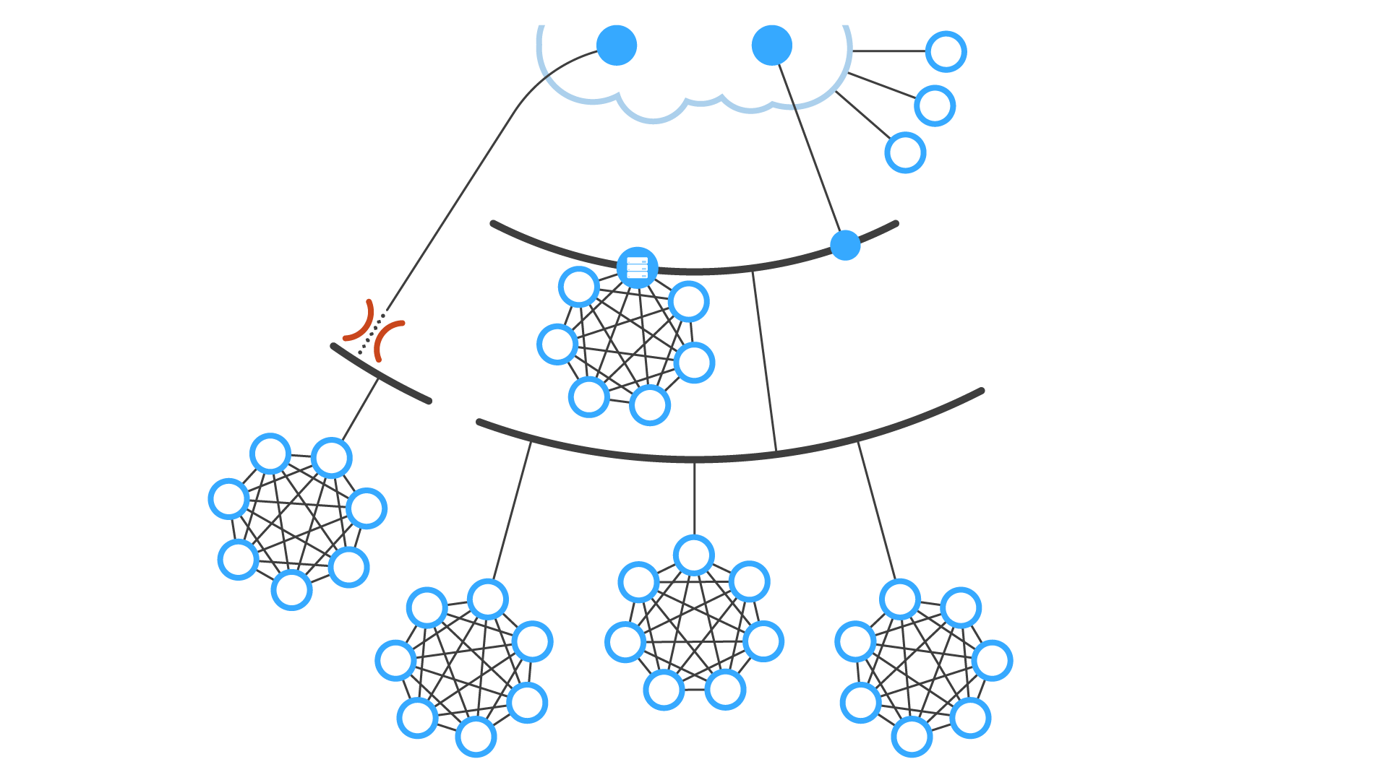
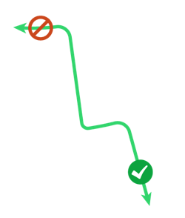
SOFTWARE DEFINED CONFIGURABILITY
Control Where Needed
Allow high-capacity locales to serve limited locales, but not vice-versa
Isolate and throttle VPN use
Cap bandwidth in limited connectivity locales
Associate internal grid servers with specific locales
Plus dozens of additional essential controls for complex, global enterprises
Notes:
The Kollective system provides for extensive software-defined configurability and control over the operation of the distributed peering grid, essential in the huge, very heterogeneous global corporate networks we find today. Many corporations have complex security and connectivity policies and see very large disparities in capacity and bandwidth from the core to the edges of their networks, so it is crucial that a peer-based SD ECDN can be partitioned and fully-controlled to match the different needs in wide-ranging localities across the globe.
This build slide shows some of the configurability cases we have accommodated in actual customers.
For global events, it is not uncommon to have many viewers joining remotely via VPN, because of time-zone differences and the general trend towards mobility and telecommuting. It is essential to be able to control the peering and bandwidth use of such nodes, and Kollective allows that to be easily established.
In remote offices where WAN bandwidth may be heavily constrained, establishing locale-based throttle caps and specifying preferred video bitrates ensures trouble-free viewing without interrupting business-critical use of the shared links.
Some locations have excess bandwidth and so can act as regional server pools for downstream locations, but is it essential that serving in the other direction is restricted.
Kollective supports the placement of remote origin servers in select locations, often for security purposes, and peering policies can be established that define which locales can access and draw origin copies from these servers.

Slide 24
CLOUD CONTENT PLATFORM SHARED SERVICES
API
Developed on Microsoft reference architecture
EXTENSIBLE PLATFORM
Supports other content delivery use cases
NETWORK OPTIMIZED
Optimized for each network topography

Slide 25
BENEFITS SUMMARY
Accelerates Windows 10 / Windows as a Service migration
Rapid deployment of latest feature updates
Increased end-point security from immediate security patches
Optimized for minimal network bandwidth usage
No additional hardware required
90% reduction of distribution points
Notes:
Windows 10 migration / Windows as a Service upgrade cadence
Current distribution point model not suited for Windows 10 upgrade package file size and cadence
Speed of installation and upgrades
Days vs weeks/months
Full automation of upgrade process
Pre-staging upgrade packages eliminates upgrade failures
Minimal network bandwidth impact
Network topography optimized peer-assisted delivery
90% reduction of distribution points
Each PC serves as a distribution point
Increased end-point security
Windows 10/Windows as a Service

Slide 26
WHY CUSTOMERS CHOOSE KOLLECTIVE
INTELLIGENT
BATTLE TESTED
Self Optimizing
Software Defined ECDN
4M
End Points Deployed
Highly Configurable
For your unique network
16
Years of Market Experience
Secure Delivery
Protecting your content
97%
Renewal Rate
Powerful Analytics
& Network Readiness Test
100+ Global 2000
References
Notes:
SOME IMAGE Mature, Configurable, Secure, NRT / Analytics
Why customers should choose Kollective:
Self Optimizing: The cloud directory server uses a set of heuristics to automatically provide lists of peers that are as close as possible to the requesting agent. The Kollective agent software monitors the response times and available bandwidth of each peer that is serving the file, and adaptively requests more data from the endpoints that provide the best throughput. The agents in the Kollective SD ECDN will automatically optimize to focus on the endpoints that have the topologically closest and least congested connections, naturally adapting in real-time.
Highly Configurable: The Kollective SD ECDN has over 600 parameters that can be configured to control the behavior of the smart grid. For 80% of the time, the smart grid runs on its own intelligence. But 20% of the time, controlling the behavior of the smart grid is critical to the success of large deployments.
Powerful Analytics: Kollective's view is that both end user and network analytics are essential for a full 360-degree view of the event. Compared to Hive, we have all the same Delivery metrics (and more) plus viewership data (client or client-less).
NRT: Kollective Network Readiness Test (NRT) is a collaborative service in which Kollective consults with the customers’ enterprise IT teams to test their networks readiness for a live video broadcast. Kollective runs a test showing the benefits of peering efficiencies on the customer network and provides recommendations for configuring SD ECDN agents for network optimization. Our NRT has been used to guide the deployment of over 2 million agents.
Battle Tested: Our biggest strength is our experience dealing with complex network architectures and dealing with IT departments of major corporations. It took us years to perfect our system through rigorous lab testing and more importantly, actual testing on massive enterprise networks. We know the pitfalls and have taken steps to prevent them. Our Seats Deployed, Customer List, and Renewal Rate are the Proof Points.

Slide 27
Notes:
JUST KOLLECTIVE

